Slide 1

Application: DonationPlace Solution Type: Application Architecture View: Logical View Style: Layered Architecture Pattern
Users
Deliver Channels
Core Business Processes
Data And Information
Technology Enablers
User Account
User’s Personal
Messaging Bus
Mobile App
Customers
Admin Account
Donation Information
Real-time Bus
Internet
Home
filtering Data
E-Payment
Administrators
Activities Board
Email
Web Services
Payment Information
React-Native
Vendors / Non-Profit + Gov’t Organizations

Slide 2
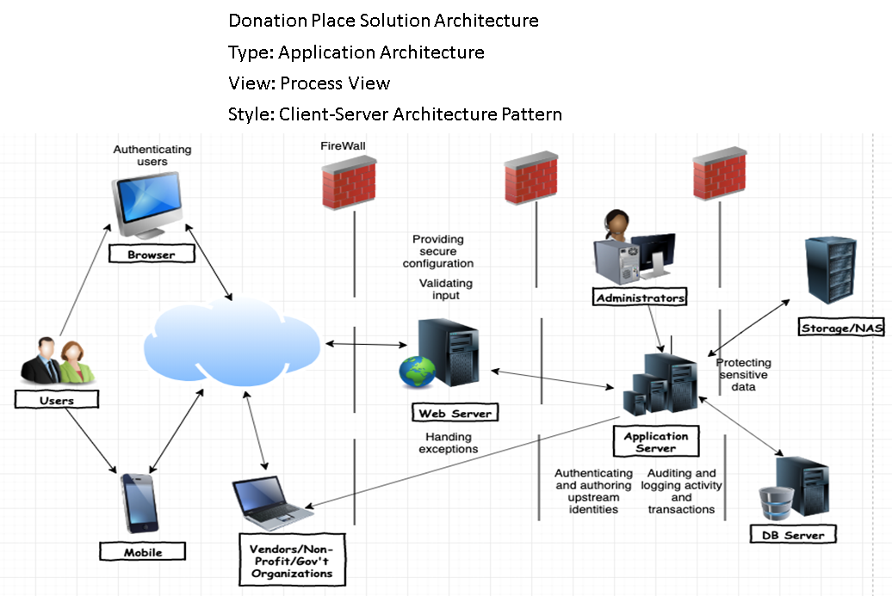
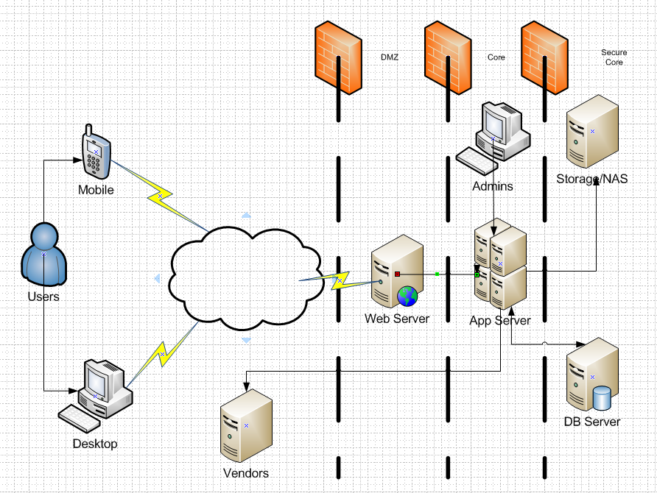
Application: DonationPlace Solution Type: Application Architecture View: Process View Style: Client-Server Pattern

Slide 3
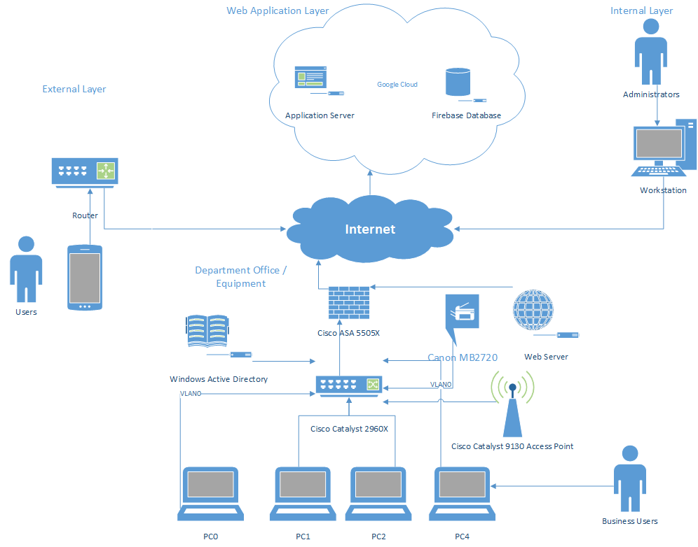
Application: DonationPlace Solution Type: Application Architecture View: Physical View Style: Physical Architecture Pattern

